Slide 1
FYP Presentations
Jim Buckley
Department of Computer Science
and Information Systems
Notes:
Well done on getting all the proposals in
Real opportunity to get some work under your belt
Directed at presentations

Slide 2
Introduction
On week 6 (14th - 18th of October), at the time scheduled for you, each student is required to make a presentation on their project progress.
The FYP presentation is mandatory and first term marks are awarded for it:
  20% Games, CS and MMPT
  10% DMD
The normal (medical or otherwise) certification must be presented to the FYP coordinator if a student is to miss his/her presentation date.
For a presentation date missed without certification, 5% will be deducted from the final mark.

Slide 3
Purpose of the FYP presentations
Unless you are doing an Own project, which you have already fully explored, you will probably have started your project with only a title and a few words of explanation.
In the weeks between taking on the project and giving your FYP Presentation you should have done sufficient research into your project to get a good understanding of the project, its scope and the difficulty of the task you have undertaken.
The purpose of the FYP Presentations is –
  To demonstrate to your supervisor, and the other attendees that you are on track….
  To describe your plan for how you intend to proceed for the future.
  To get outside feedback on that work-rate and plan

Slide 4
Presentation Topics 1
You should have at least one slide addressing each of the following topics.
Title
Project name, student name, course, supervisor name
Project Summary
You should give a brief overview of what the project is about and why it is important. This is similar to, but more in-depth than, the summary at the beginning of the FYP report. “Scenarios of use”/Examples are very useful here.
Project Environment
You should identify the languages, technologies, tools etc that you intend use for your project and you should justify your choices.

Slide 5
Presentation Topics 2
Research/work to date
You should provide a review of existing research (papers, books, other FYPs) in the area, or of existing similar systems, compositions, installations, showing where yours fits in.
Description of Current Progress
You should give a brief description of the progress you have made to date and should support your description with some evidence (Such as a database schema, screen mockups, User Interface design, animations, visualizations)
Project Plan
You should present a plan showing how you intend to proceed (tasks you need to undertake, milestones etc).

Slide 6
Papers read to date
Murphy et al, 2006: the only paper to study programmers interaction with IDEs…
Other papers focus on researcher prototype plug-ins to help programmers
  JITTAC (Buckley et al 2013)
  Mylar (Murphy et al 2005)
Surely we need more of the former to help us correctly propose the correct plug-ins.

Slide 7
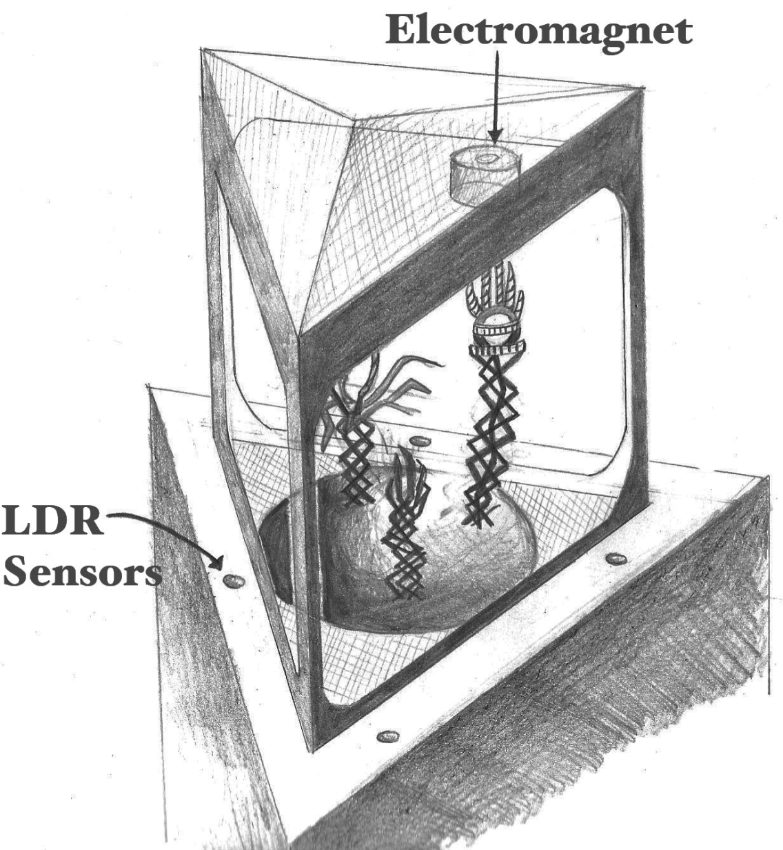
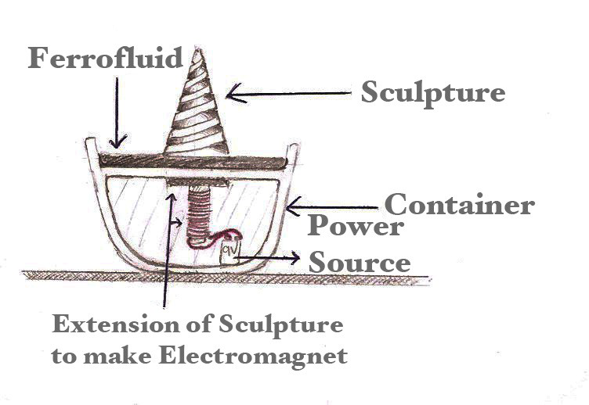
Installation Design Sketches
“Evolving Hands” An interactive installation using Ferrofluid.

Slide 8
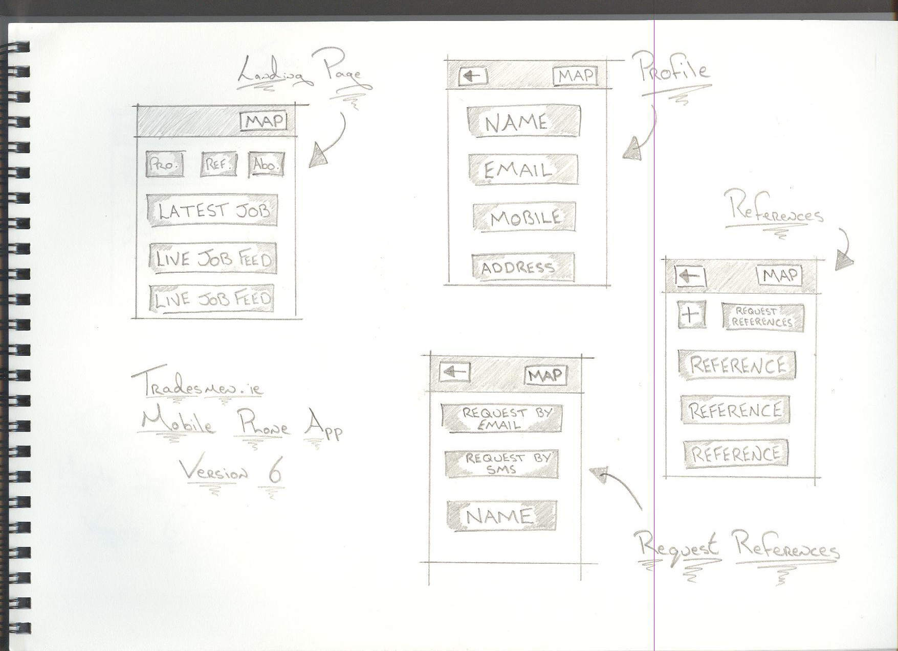
Concept Sketches

Slide 9
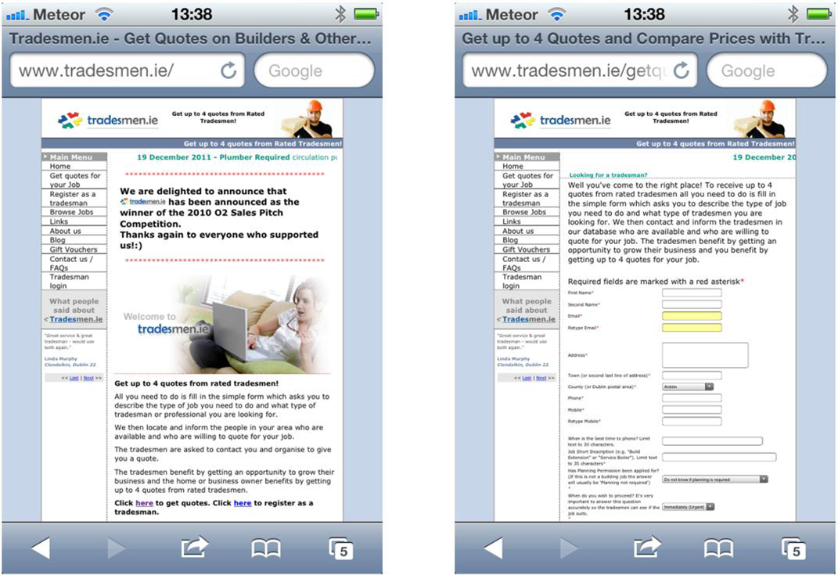
Research or Screen Mockups

Slide 10
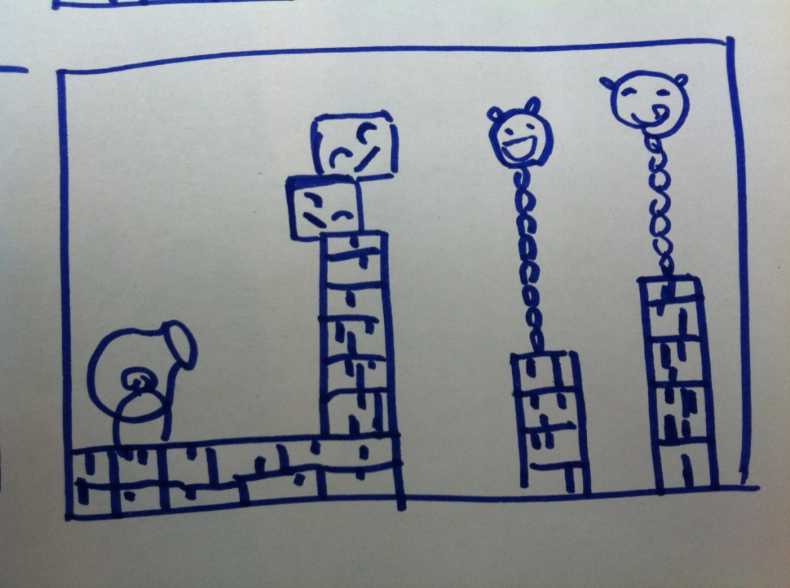
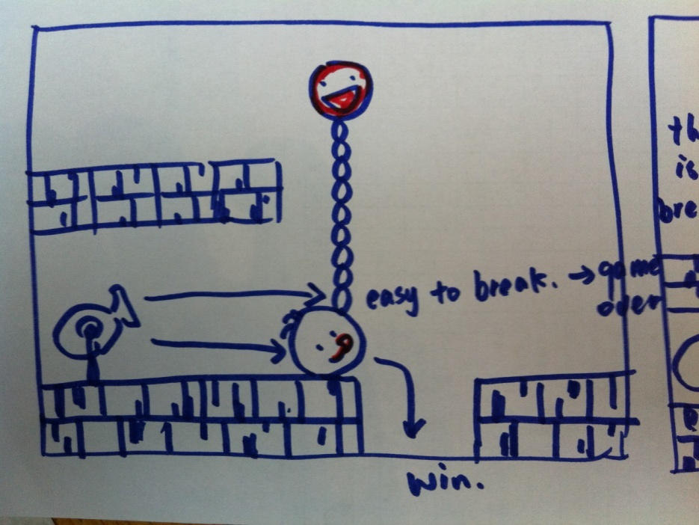
Game Design Sketches

Slide 11
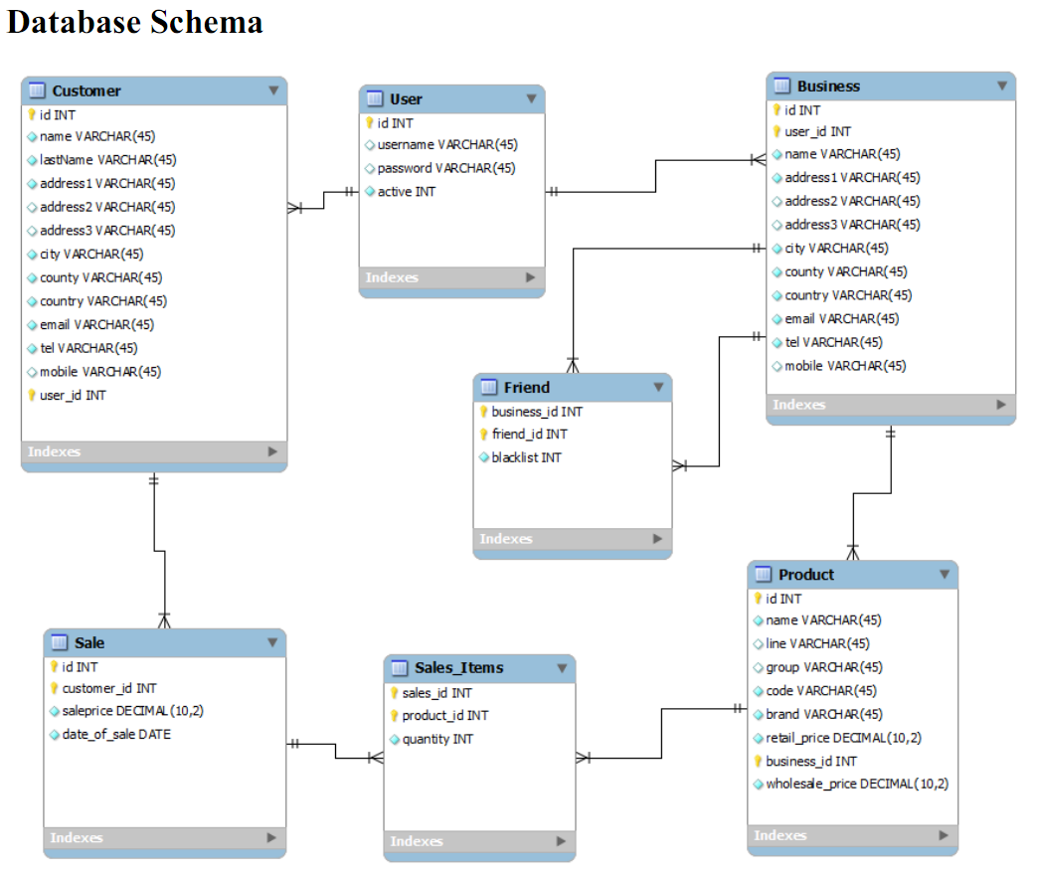
Evidence of work: Database Schema

Slide 12
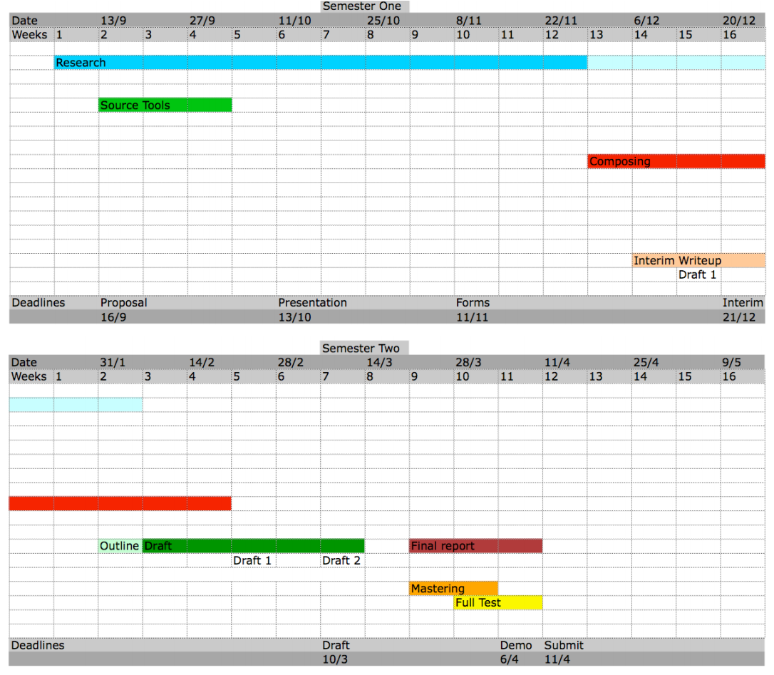
Project Plan 1

Slide 13
Presentation Mechanics
You will receive an email assigning you to a presentation time slot, before the end of next week (hopefully).
Each presentation slot will be attend by two supervisors and (normally) six students.
You are expected to turn up on time and remain for all the presentations (2 hours).
There is no dress code.
The panel of supervisors who attend your session will give you verbal feedback on your presentation.
You should have a ‘scribe’ take note of these comments. Perhaps you might arrange a quid pro quo with one of the other attendees...

Slide 14
Presentation Mechanics 2
Each presentation should take no more than 20 minutes. Of that 20 minutes you will need to reserve about 5 minutes for questions.
So the actual presentation itself should be about 15 minutes long. This typically equates to about 6 -12 Powerpoint slides, depending on your style.
Please keep in mind that 15 minutes is not very much time so a huge amount of detail is not required.
Its very important to have (at least) 1 dry-run.
With colleagues who will tell you if you have B.O.!

Slide 15
Scenarios of use
For each kind of user, write a scenario of use that details how you think they might interact with the project.
A scenario of use is a very useful thought experiment that allows you to explore how different kinds of user might interact with your project.
If the project is a software application, then scenarios of use allow you to explore the kind of functionality your application needs to provide and they allow you to identify the different kinds of user who might use the application.
I’m not so sure re an installation, but…
Notes:
Scenario Of Use For Procurement Website
Jim
Jim O’ Brien is the manager of a small company making water boilers. The elements for these boilers are purchased from the UK but the fall in the value of the Euro has significantly increased the cost of the elements and this has had an impact on the profitability of the boilers.
Jim has been trying to find a source for the elements within the Euro Zone and has recently come across a web site – www.Tenders.ie - which he hopes will solve his problems.
Jim connects to the web site and enters the buyer part of the site. Here he is asked for various registration details including his email address When he has entered these details he leaves the web site and a day or two later his Username and Password are emailed to him.
Armed with his new Username and Password Jim connects to the site again. This time he logs on to the buyers part of the site and, using the forms provided, creates a Request for Tenders for the kind, and quantity, of elements that his company requires. In the RFT he mentions the current cost of the elements to give potential sellers some idea of the price they will have to better or match. He also gives an expiry date for the RFT. Finally he supplies the credit card details to pay for including the RFT on the site.

Slide 16
Remember
Get ahead while you still can...
Evidence is more important than ‘I have a DB schema defined’
Have a dry run with some who’s honesty you trust, possibly even your supervisor.
This is only an opportunity to:
  Refine the work, with outsider feedback;
  Kick start the work;

